Slide 1
IS4250 Project
Selection of Resistant Bacteria at Very Low Antibiotics Concentrations
Kerine Tan Alicia Soh

Slide 2

What is a bacteria?
-Bacteria are single celled organisms
-Some are harmful
-Some can be useful
Notes:
Alicia: Bacteria are microscopic single-celled organisms that thrive in diverse environments. They can be found anywhere. They can be found within soil, in the ocean and even inside the human gut. Bacteria can be beneficial as well as detrimental. An example of useful bacteria would be the bacteria found in the human gut. These bacteria and other microorganisms aid in digestion and help in the development of the immune system. Moreover, the disruption of gut bacteria has been linked to certain disease conditions. For our presentation, we will be focusing on bad or harmful bacteria. Harmful bacteria can cause infections such as pneumonia - lung infection, cholera - infection of the small intestines (by e choli).

Slide 3

What is an antibiotic?
-Antibiotics are used to inhibit and “kill” bacterial growth
Notes:
Alicia: Antibiotics are chemicals that kill or inhibit the growth of bacteria and are used to treat bacterial infections. They either prevent the bacterial cells from multiplying so that the bacterial population remains the same, allowing the host’s defence mechanism to fight the infection or kill the bacteria, for example stopping the mechanism responsible for building their cell walls.

Slide 4

What is antibiotic resistance?
-However, the bacteria can mutate to a stronger / alternative form
-The antibiotics that were used previously to inhibit the particular bacterial growth is now no longer effective
-The bacteria is said to be antibiotic resistance
Notes:
Alicia: Bacteria are termed drug-resistant when they are no longer inhibited by an antibiotic to which they were previously sensitive. How do they become antibiotic resistance? Antibiotic resistance occurs when bacteria change in some way (in other words, mutate) that causes them to reduce or eliminate the effectiveness of antibiotics designed to cure or prevent infections. This emergence and spread of antibacterial-resistant bacteria is due to both the over-use and misuse of antibiotics.

Slide 5
How do we select resistant bacteria?
-Select resistant bacteria : by using high concentrations of antibiotics
-Those bacteria that are resistant = they will survive
-Those bacteria that are not resistant = they will not survive
Notes:
Alicia: Usually, when one conduct an experiment to select for resistant bacteria, one would use a relatively high concentration of antibiotic together with several forms of bacteria. Bacteria that confer the resistant property would survive while those that do not, will not survive.

Slide 6
Can we use low concentrations?
-The research paper shows that it is possible
-This is a problem.
-If high concentration = cause bacteria to mutate = thus able to select for antibiotic resistant bacteria
-Low concentration is also able to select for antibiotic resistant bacteria = can also cause bacteria to mutate
Notes:
Alicia: However, in the research paper that we selected, we learnt that a very low concentration of antibiotic can also select for resistant bacteria (my groupmate kerine will be going through this later). Since resistant bacteria can be selected at low concentration of antibiotics, this means that bacteria can mutate (to become resistant) at low antibiotic concentration. And this is a problem.

Slide 7
Why is antibiotic resistance scary?
-Antibiotics resistance means that:
A longer, persistent bacterial infection
A higher likelihood of complications from the infection
A persistent bacteria, which remain infectious for longer period of time, and pass the infection elsewhere, and escalates the problem
Notes:
Alicia: Antibiotic resistance is a big problem and is scary as if a bacteria is said to be resistance, that means that the infection will last longer. The antibiotic is unable to fight against the bacteria to cure the infection. It also means that there will be a higher likelihood of complications from the infection - be it more side effects from the infection. Last but not least, a persistent bacteria, which remain infectious for longer period of time means that it can pass the infection elsewhere (e.g. from one person to another), escalating the problem. I will now pass the time over to Kerine who who will be going more in depth about the experiment conducted in the paper, challenges as well as contributions that the paper has made to the field of health.

Slide 8
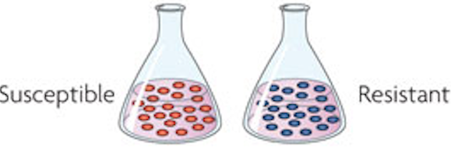
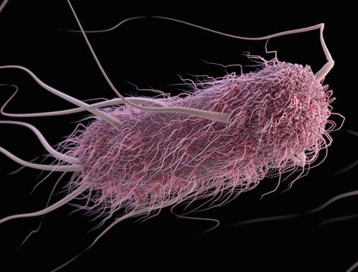
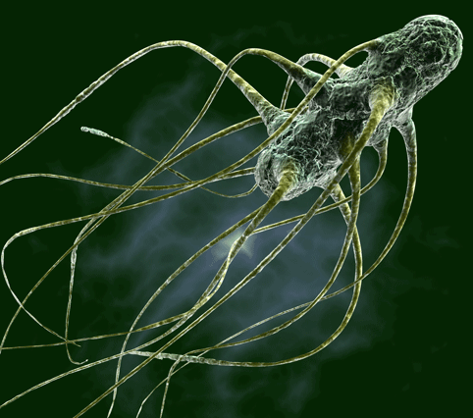
Experiment
Competition Experiment
Tetracycline
Fluoroquinolones
Aminoglycosides
Escherichia Coli
Salmonella Enterica

Slide 9
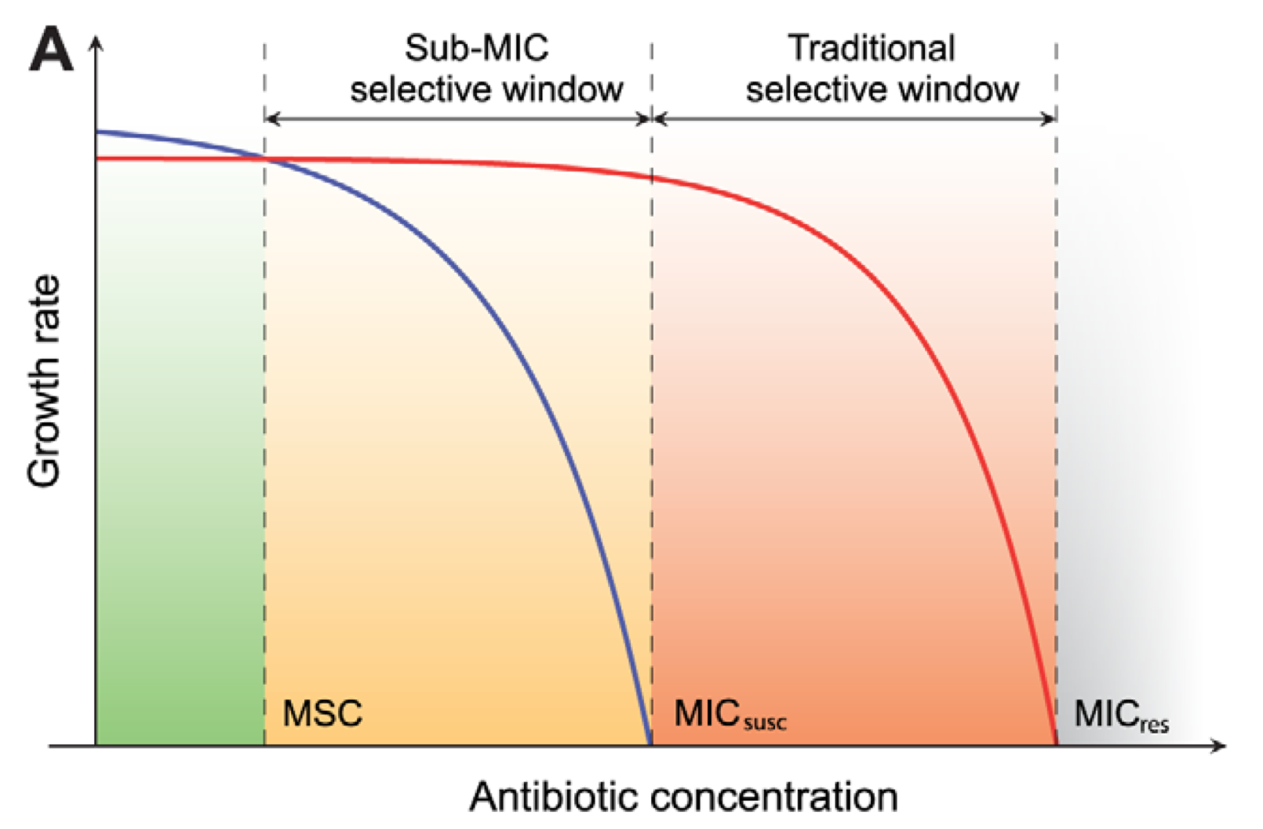
Experiment Key Findings
At concentrations below MICsusc concentration:
Growth rate of susceptible strain was significantly reduced
Growth rate of resistant strain was minimally reduced
Suggests that resistant strain are strongly selected at these low concentrations

Slide 10
Experiment Key Findings
As concentrations falls from MSC concentration:
Growth rate of susceptible strain was slowing increasing
Growth rate of resistant strain was almost plateau
Suggests that low level of antibiotic concentration give rises to new resistant mutant bacteria

Slide 11
Experiment Limitations
Only 2 bacteria and 3 antibiotics are chosen to conduct experiment on
Chemical structure of bacteria and antibiotics are getting more complex and ever evolving
Experiment not representative of the entire antibiotic and bacteria landscape.
Experiment conducted in a definite pristine condition without any externalities
Not reflective of the reality where there is a lot of factors that determine the mutation and takeover rate.

Slide 12
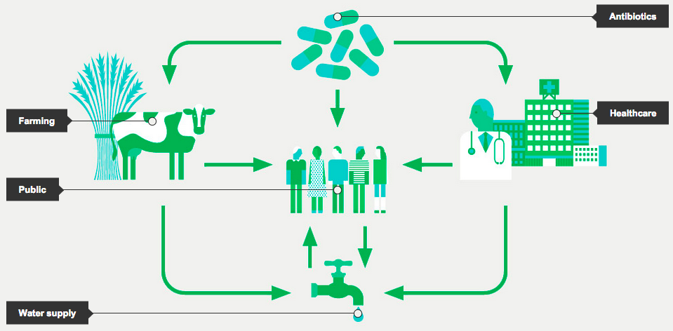
Healthcare Contributions
Environment bacteria slowly gain resistance
Emergence of superbug
Need to introduce measures to reduce antibiotics pollution

Slide 13
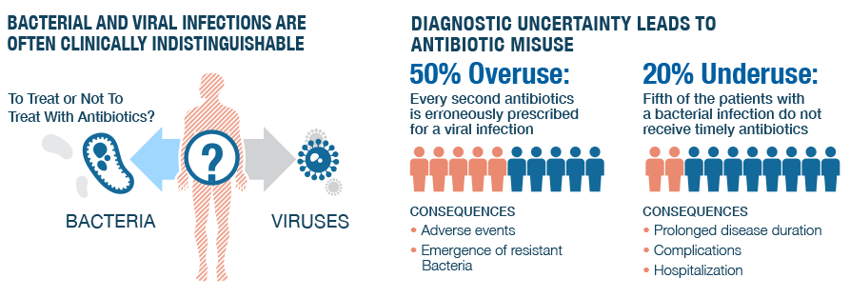
Healthcare Contributions
At high antibiotic concentrations (antibiotic overuse), only pre-existing resistant mutants will survive
At low antibiotic concentrations (antibiotic underuse), the bacteria population is allowed to grow
Allows a continuous supply of possible resistance mutations without being eradicated
Need to introduce standards to prescribe the appropriate amount of antibiotics

Slide 14
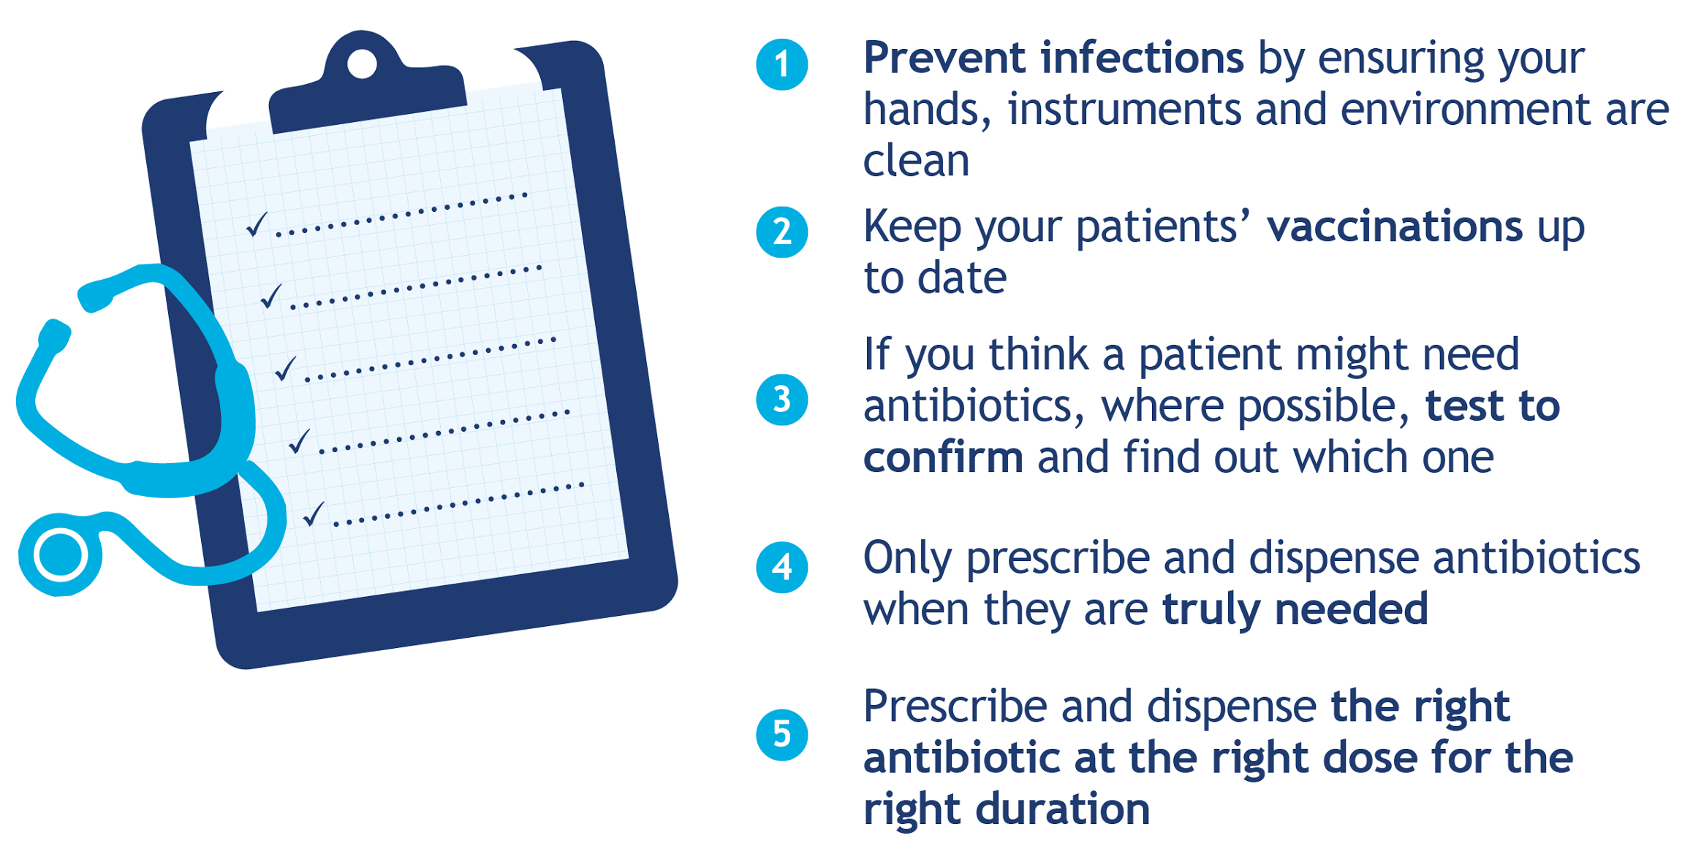
Healthcare Industry Actions
What HEALTH WORKERS can do:
Notes:
World health organization

Slide 15
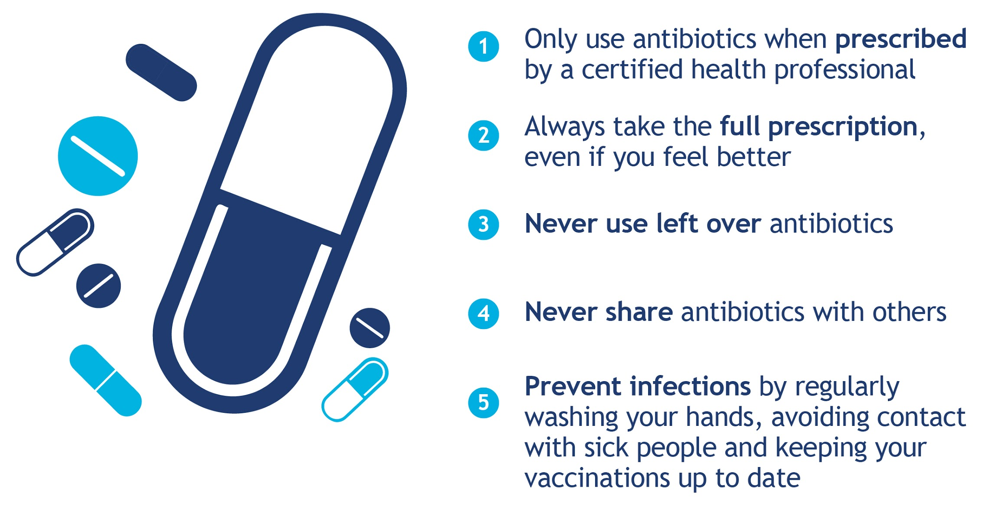
Healthcare Industry Actions
What YOU can do:
Notes:
http://www.who.int/mediacentre/events/2015/world-antibiotic-awareness-week/infographics/en/

Slide 16
Thank you
Any Questions?

Slide 17
Pre-Prepared Questions

Slide 18
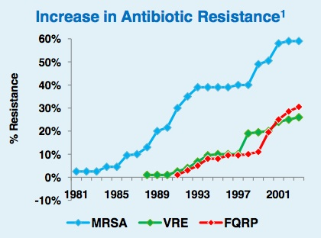
Future of Antibiotic Resistance
The World Health Organization has warned that "many common infections will no longer have a cure and, once again, could kill unabated".

Slide 19
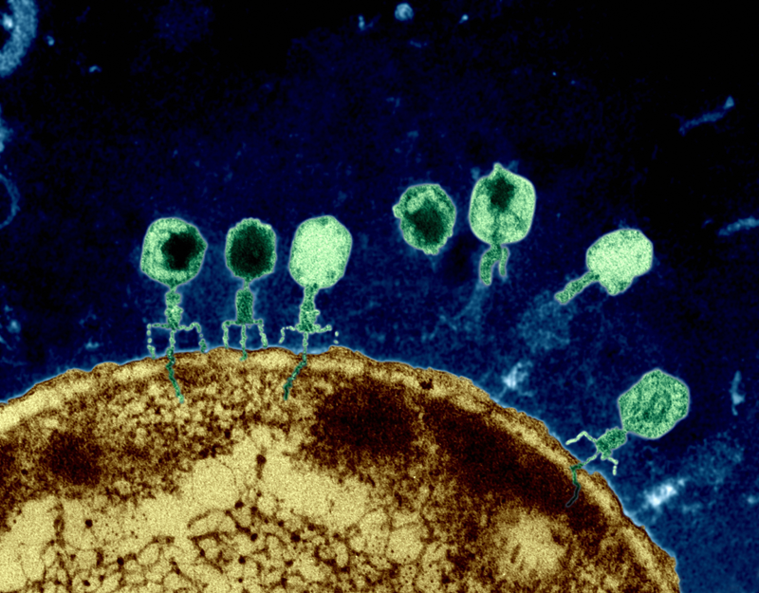
Alternatives to Antibiotics?
Using of enzymes of bacteriophages to attack the bacteria.
Notes:
Using of enzymes of bacteriophages to attack the bacteria. Bacteriophages are tiny viruses that infect bacteria. After they infect the bacteria, they replicate or make copies of themselves, and then leave the bacteria to go and infect other bacteria. To be able to leave the bacteria, the "phages" make an enzyme that dissolves the wall of the bacterial cell, thus killing it. Unlike antibiotics, the enzyme does not seek out the bacteria in all the body's hiding places, but instead just kills the bacteria on contact. The researchers envision that the enzyme could be administered in the form of a spray, to the mucous membranes, for instance, thus eliminating the source of the disease bacteria.

Slide 20
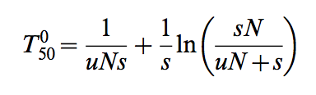
Experiment Key Findings
With fixed u and N, high s,
T > 1000,
and changes to resistant tend to be slow
With fixed u and N, low s,
100 <= T <= 1000,
and changes to resistant tend to be fast
Suggested that low antibiotics concentration give rise to resistant bacteria more easily
, where u = mutation rate of bacteria,
N = population size of bacteria,
s = fitness advantage of antibiotics, determined by the different concentration of antibiotics,
T = stochastic waiting time (population) for first mutant to appear

Slide 21
Additional Healthcare Contributions
Secondly, at very low antibiotic levels, which are present in many natural environments or generated in certain body compartments during treatment, are contributing factors for the enrichment and maintenance of pre-existing resistant mutants as well as for the de novo selection of new mutants. This occurs due to differences in growth rate at the particular antibiotic concentration between cells with different tolerance levels to the antibiotic. Resistant mutants selected at low antibiotic concentrations are generally more fit than those selected at high concentrations.
Thirdly, it is essential for the use of treatment dosing regimens7 that preclude prolonged time periods of sub-MIC levels of antibiotics. The two most straight-forward interventions are either to isolate antibiotics at the source (e.g. by urine separation in hospitals or by limiting runoff from animal facilities) or to destroy antibiotic downstream at the place of contamination when it no longer serve its purposes.

Slide 22
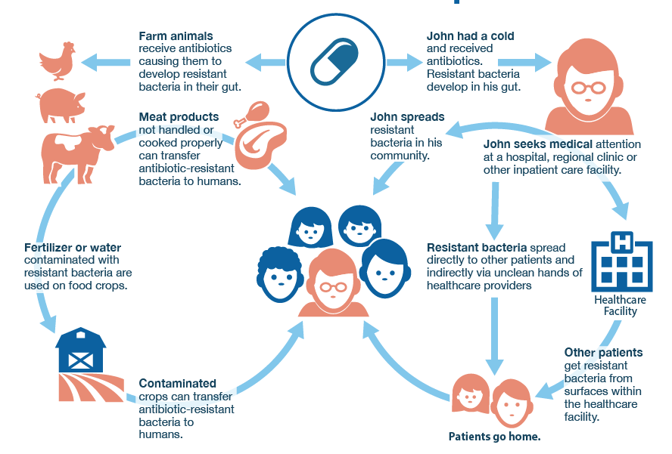
How can antibiotic resistance spread

Slide 23
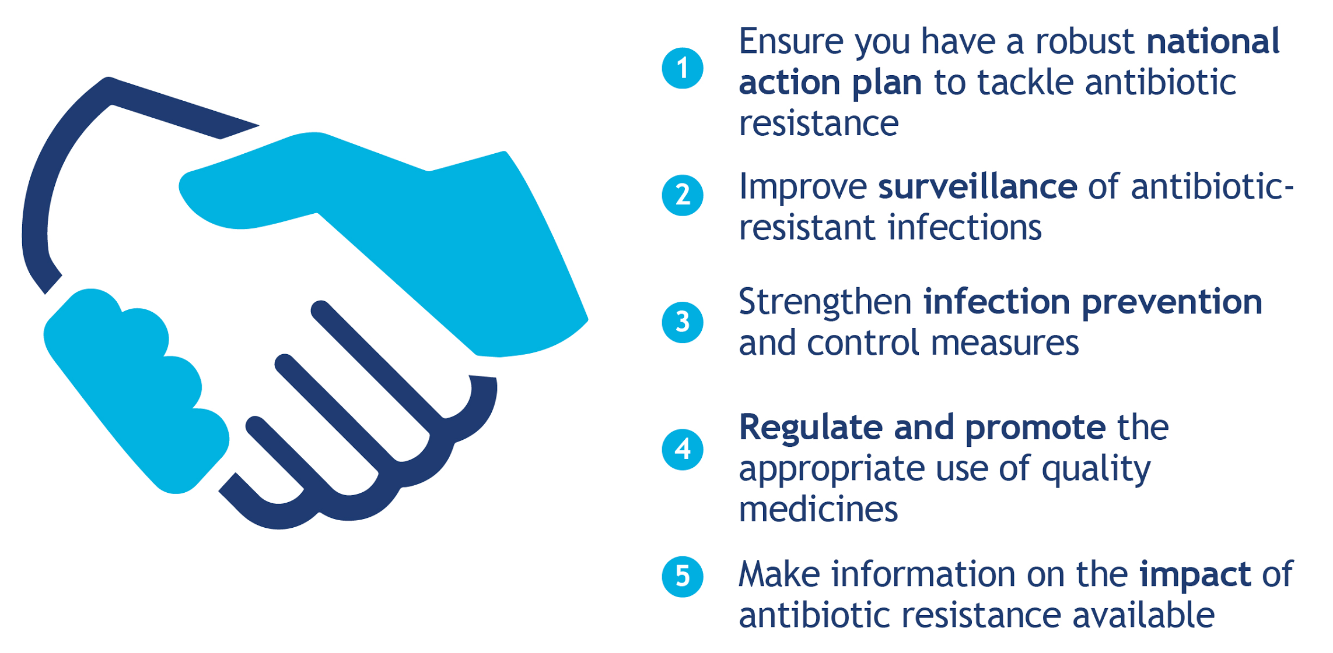
Additional Healthcare Industry Actions
What POLICY MAKERS can do:
Notes:
http://www.who.int/mediacentre/events/2015/world-antibiotic-awareness-week/infographics/en/

Slide 24
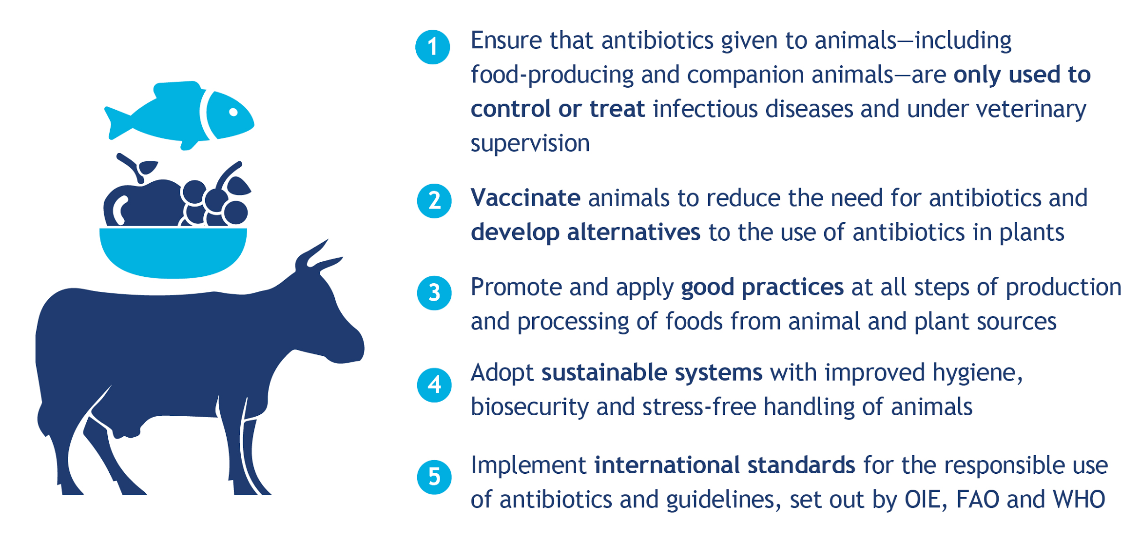
Additional Healthcare Industry Actions
What AGRICULTURE SECTOR can do:
Notes:
http://www.who.int/mediacentre/events/2015/world-antibiotic-awareness-week/infographics/en/

Slide 25
Additional Limitations of Experiment
The competition experiments performed with a low initial fraction of resistant mutants were done with tetracycline due to the long time required for the appearance of de novo tetracycline resistant mutants that might disturb the competition experiments. Given that similar experiment is not conducted for the other 2 antibiotics, the conclusion derived can only be concluded for tetracycline and not for the entire experiment.

Slide 26
Author’s Experiment Limitations
There are several differences between experiments and real world. Antibiotic resistance is reversible in bacteria. However, it is more effective in experiments than compared to real world. Several factors contribute to this irreversibility, including the absence of a fitness cost, reduction of the fitness cost through compensating mutations and genetic co-selection between the resistance-conferring gene and another gene under selection. The sub-MIC selection observed in the experiment could also be a significant contributor to this long-term persistence of resistance where very low antibiotic concentrations in the environment are sufficient to maintain the existing resistant bacteria in the population by further balancing the fitness cost of the resistance.
Another issue is the concept of mutant selective window needs modification. It is assumed that antibiotic concentrations below the MIC do not confer selection and that the bacteria mutant selective window—the concentration range in which the resistant mutant is enriched— extends between the MIC of the susceptible wild type and the MIC of the resistant mutants. However, the experiment performed indicates that biologically relevant sub-MIC selective window needs to be extended at low antibiotic concentration, which may be several hundred-fold below MICsusc.

Slide 27
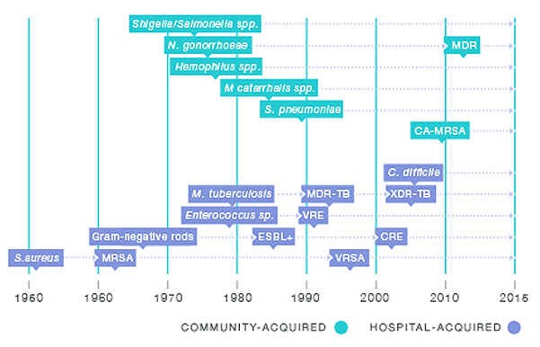
Healthcare Challenges
CRE (carbapenem-resistant enterobacteriaceae) mortality rate : 40% to 50%
MRSA (methicillin-resistant staphylococcus aureus) mortality rate: 20% to 50%
More strains of superbugs forming, causing deaths

Slide 28
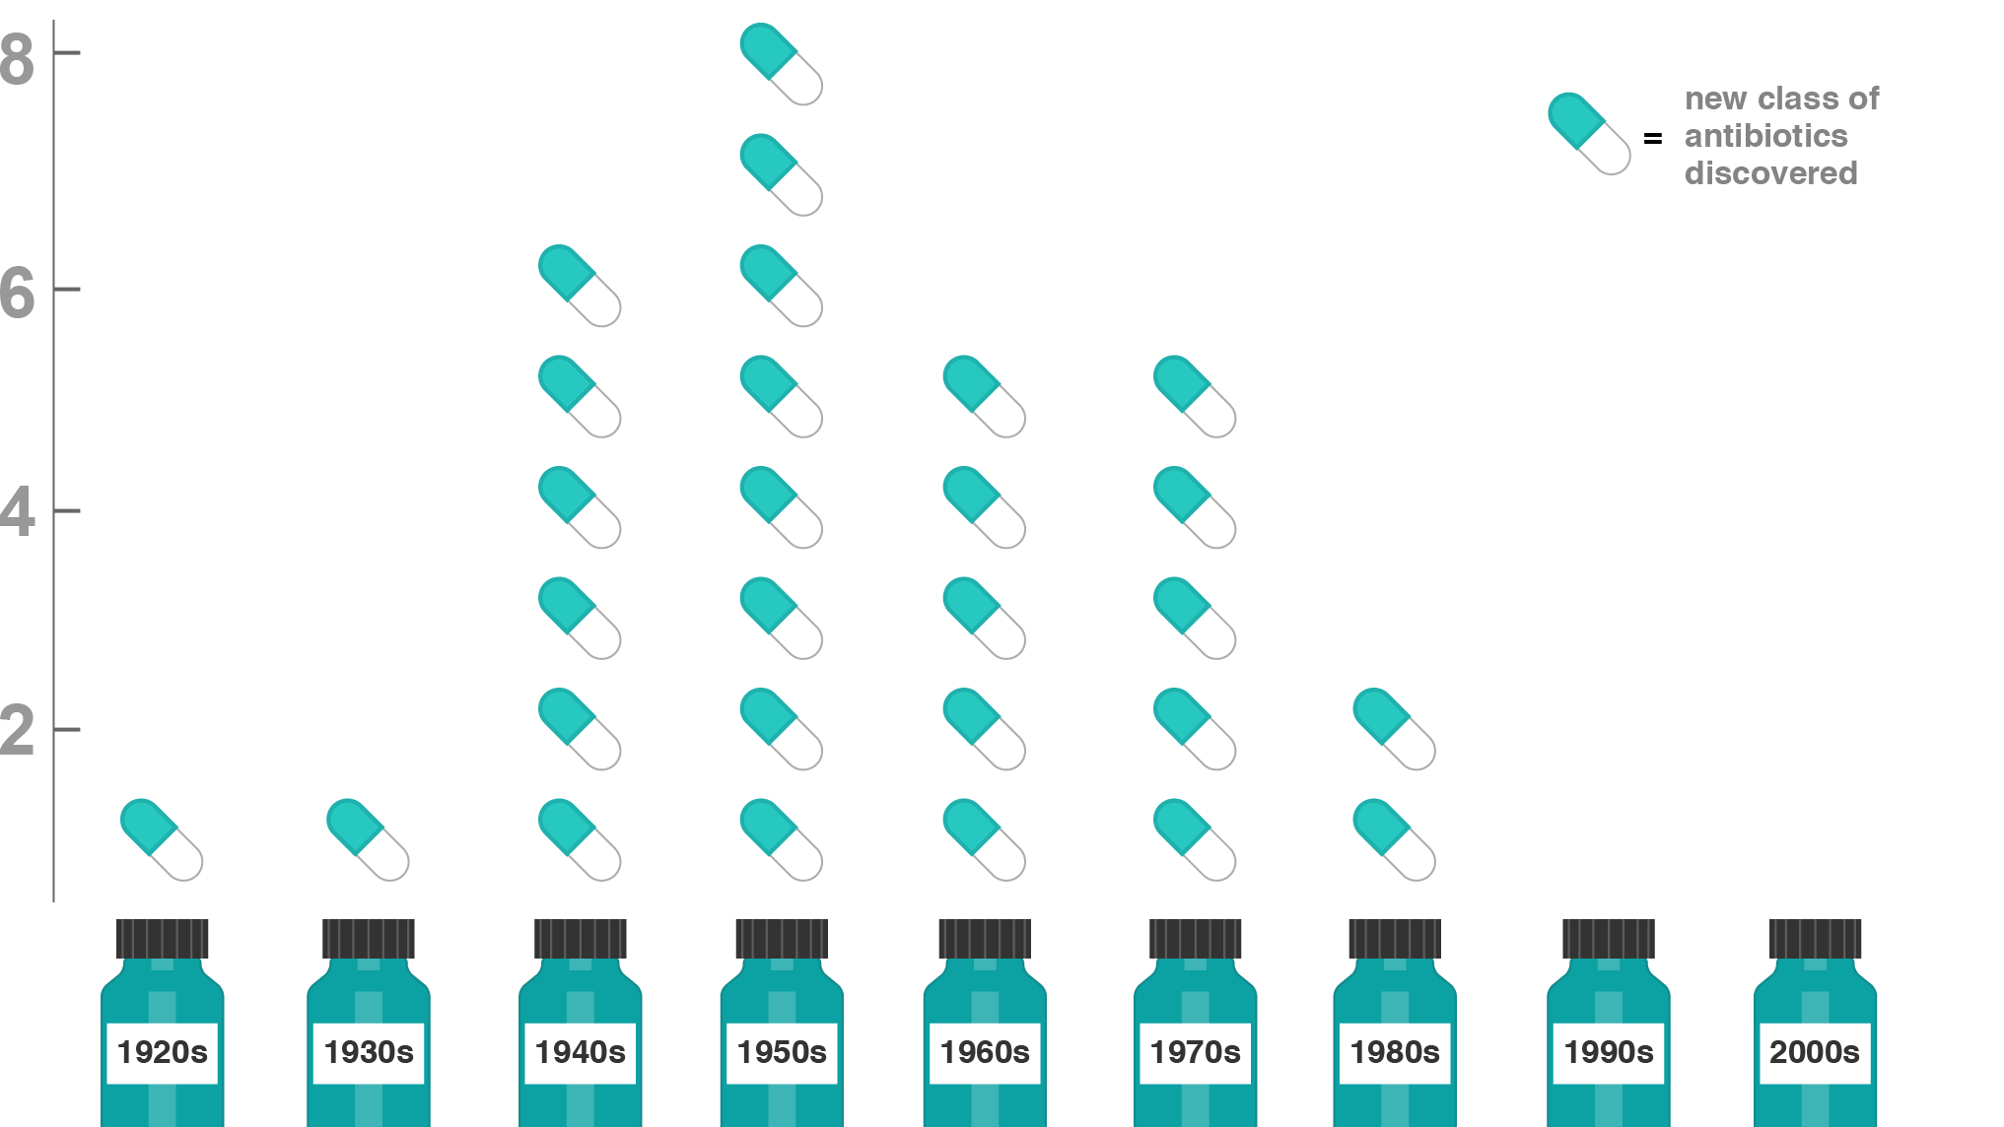
Healthcare Challenges
Consistent need to develop new antibiotics and strengthen existing antibiotics
Only 1 antibiotics developed since year 1987

Slide 29
Additional Healthcare Challenges
Regardless of the actions taken to reduce antibiotics pollution, there will still be a small extent of pollution that is hard to eradicate.
There will still be presence of low antibiotic concentrations due to anthropogenic input pollute natural (e.g. aquatic or soil) environments, that are produced naturally by antibiotic-producing micro-organisms or that are present in certain human/animal body compartments during therapeutic or growth promotion use. These can be potential platforms for the selection and enrichment of resistant mutants.
The paper emphasizes that low antibiotic concentrations can affect the emergence and maintenance of resistant mutants in bacteria. Thus, it is important that the relevant authorities to introduce measures to reduce antibiotic pollution. Although there are already measures introduced, it is still a challenge for authorities to regulate the prevalence of antibiotic pollution.

